Slide 1
NYCDEP Comments on East Branch Early Action
June 12, 2023
Notes:
Intro and thanks

Slide 2
Introduction
The City is supportive of the East Branch Early Action (EA).
Addressing a major contaminated segment of the Creek sooner rather than later is a good idea.
The East Branch is a sensible area to conduct an EA.
However there several key concerns that must be addressed:
The CSM is highly uncertain, significant ongoing sources of COPCs, including groundwater (GW) and NAPL, are not sufficiently characterized.
Anthropogenic Background should be considered for cleanup goals for an area designated as Significant Maritime Industrial Area (SMIA)
Ongoing risk and recontamination due to ongoing Oil/Tar (NAPL) from upland Sites must be a remedial action objective (RAO) for the Site
Bulkhead stability must be considered for the EA.
EA FS must address these concerns for success
Notes:
1) Focus on concerns
2)Bulk of presentation on concerns 1-3. we want it to work but to blunt we don’t want to be left holding the bag.
3) Lot of slides so go quick, note the slide number

Slide 3
Concern 1: CSM Uncertainty is High

Slide 4
Uncertainty for the CSM is High
CSM is basically a “solids-based mixing” model.
  Significant uncertainty exists in the Sed-Trans Model
  NAPL/GW inputs significantly impact solids entering the Creek from East River and point sources.
  Data gaps are associated with contaminants entering the Creek from uplands – i.e., GW and NAPL Seeps.
  No data in RI/FS characterizes NAPL seeping into the Creek.
The CFT model used for developing remedial alternatives currently sets the COPC loads from uplands entering to the Creek to zero.
The CFT report currently attributes inability of the model to estimate elevated concentrations in surface sediments to uncertainty in point sources (as opposed to model uncertainty).

Slide 5
PCBs in Surface Sediments at Urban Water Bodies and CSO Solids
Risk-Based Eco-PRG
Point sources have been extremely well-characterized with low uncertainty (multi-million-dollar, multi-year/seasonal program).
Notes:
LTE/background number
Concern misattribute point sources to other inputs

Slide 6
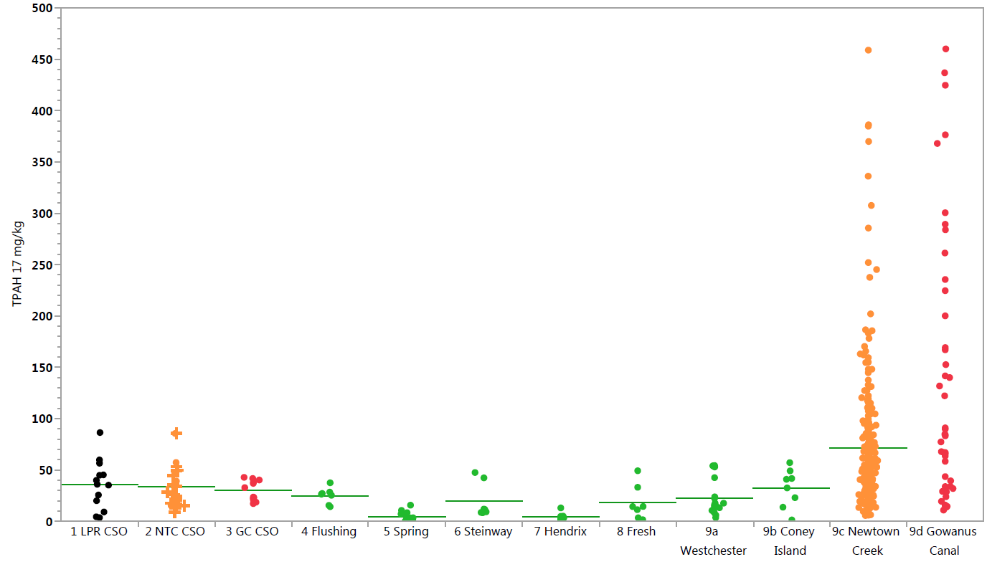
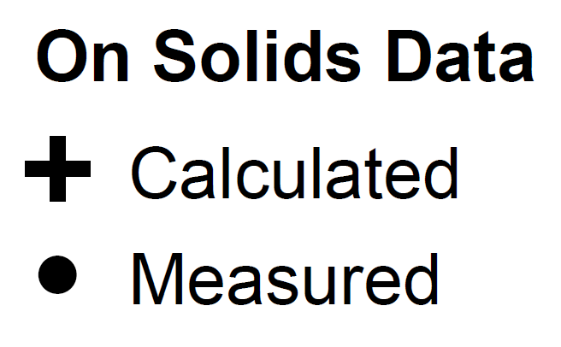
      CSO TPAH(17) levels similar across Urban Areas
Mean
Max: 1,243
Max: 6,670
4
^
8
^
TPAH - 17 (mg/kg)
Lower Passaic River
Newtown Creek
Gowanus Canal
Flushing
Spring
Steinway
Hendrix
Fresh
Westchester
Coney
Island
Newtown
Creek
Gowanus
Canal
CSO Solids
Other Urban Waterbodies
Superfund Sites

Slide 7
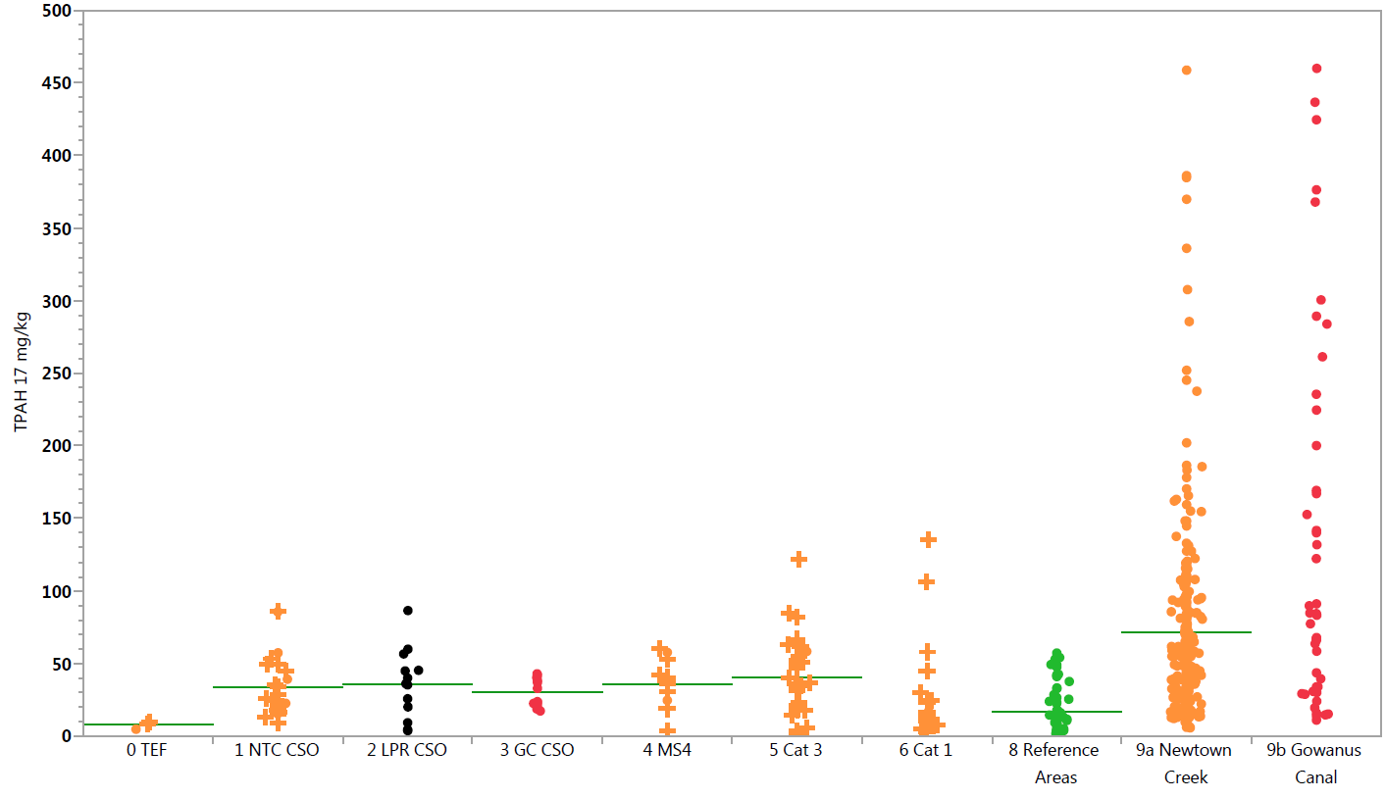
      Relative Point Source TPAH(17) Concentrations
Mean
Max: 46,478
Max: 1,243
Max: 6,670
3
^
4
^
8
^
TPAH - 17 (mg/kg)
WWTP
Treated
Effluent
Newtown Creek
Lower Passaic River
Gowanus Canal
MS4
Private / Other
Stormwater and Direct Drainage
Private Treated Effluent and Permitted Discharge
Other Urban Waterbodies
Newtown
Creek
Gowanus
Canal
CSO Solids
Stormwater
Surface Sediments
Notes:
CSO is a mix of stormwater

Slide 8
Copper in Surface Sediments at Urban Water Bodies and CSO Solids
Risk-Based PRG
Notes:
Gowanus and NC and unique industrial inputs
CSM of solids coming in from ER

Slide 9
Presence of NAPL in Sediments in Underestimated
NAPL Delineation for EA and OU1 is underestimated
  Sheens documented as part of visual observations or documented as part of Shake tests are not considered indicators of NAPL presence in sediments
    Not in accordance with NYSDEC or NOAA guidance
  NAPL presence documented under other programs is not considered as part of NAPL delineation.
Areas where sheens are documented in sediments show NAPL migration due to ebullition, including East Branch.
Notes:
At a minimum, our studies show higher. “Non NAPL”
Missing or underestimated

Slide 10
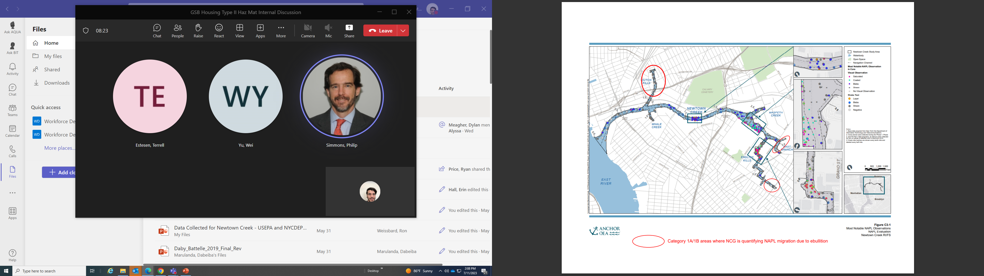
Presence of NAPL in Sediments in Underestimated
Cat 1A/1B areas (considered “non-NAPL”) have quantified NAPL migration due to ebullition (at least 60-200 kg/yr of flux)
Figure adapted from AQ RI Figure C3-1 “Most Notable NAPL Observations”
Notes:
NCG Ebullition studies show NAPL migration from sediments where the RI sates no NAPL impacts in sediments.
At a minimum, our studies show higher. “Non NAPL”

Slide 11
NAPL Mobility in Sediments is Highly Uncertain
RI states that NAPL is not mobile in sediments of the Creek.
RI used ASTM method designed for determining moisture content in freely draining soils on soft grained soils as the first step in determining NAPL mobility in sediments.
  Compressing fine grained sediments is well known to be a way to decrease permeability and therefore NAPL mobility.
  During Stage 1 testing, the sample volume was compressed by the high pressure placed on the soft samples which decreases the permeability
  This approach was rejected by USEPA Region 2 for the Quanta Resources Superfund Site in NJ for this very reason.
Sheens which were documented during subsequent tests of NAPL mobility were not considered as indicators of NAPL mobility in the RI.
No alternative tests were conducted to test the validity of this method in determining NAPL mobility.
NAPL mobility assessment is highly uncertain. Alternative testing techniques are needed during EA Remedial Design.
Notes:
Same conclusions were made for EB EA.

Slide 12
Concern 2: Role of Anthropogenic Background

Slide 13
Role of Background in Superfund Cleanups
USEPA guidance (USEPA 2002) states that “Background information is important to risk managers because the CERCLA program, generally, does not clean up to concentrations below natural or anthropogenic background levels.”
USEPA has followed this guidance to set up cleanup levels for Superfund Sites in NY/NJ (Lower Passaic River, Gowanus, etc.).
For Newtown Creek EA proposal:
  Clean up goals will be set at risk-based levels.
  Interim Performance Measures (IPM) based on Long Term Equilibrium (LTE) will be used to assess “long term performance”.
  Definition of “long-term” is unknown. 30 years? 5 years?
  This leaves the cleanup in an indeterminate state as the alternatives for EA will not meet the remedial goals
.
Notes:
1) These are draft memos, in framework
2) Call it what it is rather than coming up with new terms and confusing things. We don’t need more acronyms.
3) Background is not a sacrifice for things improving in future decades

Slide 14
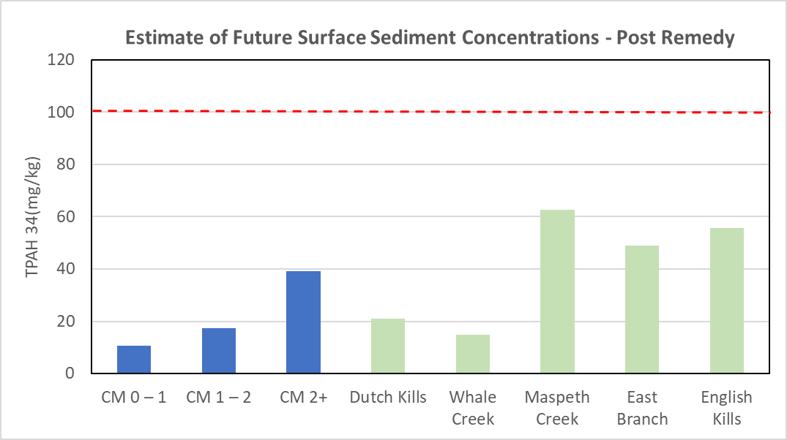
Comparison of Background with Risk-Based PRGs
Background is an estimate of the steady-state concentrations in the Creek after the entire Site has been remediated.
  Assumes ongoing sources continue at current levels.
  Ongoing sources include; East River, point sources, groundwater, shoreline erosion & atmospheric deposition.
  NAPL seeping from upland properties is not included as an ongoing source.
Background estimates are at or less than the risk-based PRGs for all COPCs except dioxin/furans.
Risk-Based PRG - Ecological
Notes:
This is the whole creek if all NAPL is controlled (ebbulition/seeps) and all other sources – CSO/stormwater, east river continue at current sources
LTE/background is actually below
8 years ago CSTAG comment
ER TPAH17 at 74

Slide 15
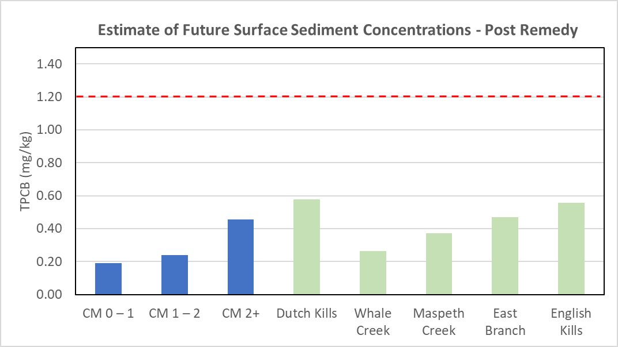
Comparison of Background with Risk-Based PRGs
Background is an estimate of the steady-state concentrations in the Creek after the entire Site has been remediated.
  Assumes ongoing sources continue at current levels.
  Ongoing sources include; East River, point sources, groundwater, shoreline erosion & atmospheric deposition.
  NAPL seeping from upland properties is not included as an ongoing source.
Background estimates are at or less than the risk-based PRGs for all COPCs except dioxin/furans.
Risk-Based PRG - Ecological

Slide 16
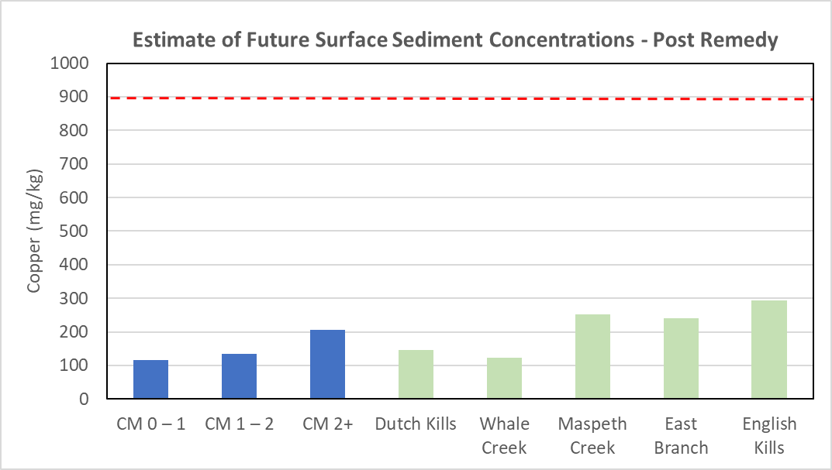
Comparison of Background with Risk-Based PRGs
Background is an estimate of the steady-state concentrations in the Creek after the entire Site has been remediated.
  Assumes ongoing sources continue at current levels.
  Ongoing sources include; East River, point sources, groundwater, shoreline erosion & atmospheric deposition.
  NAPL seeping from upland properties is not included as an ongoing source.
Background estimates are at or less than the risk-based PRGs for all COPCs except dioxin/furans.
Risk Based PRG - Ecological

Slide 17
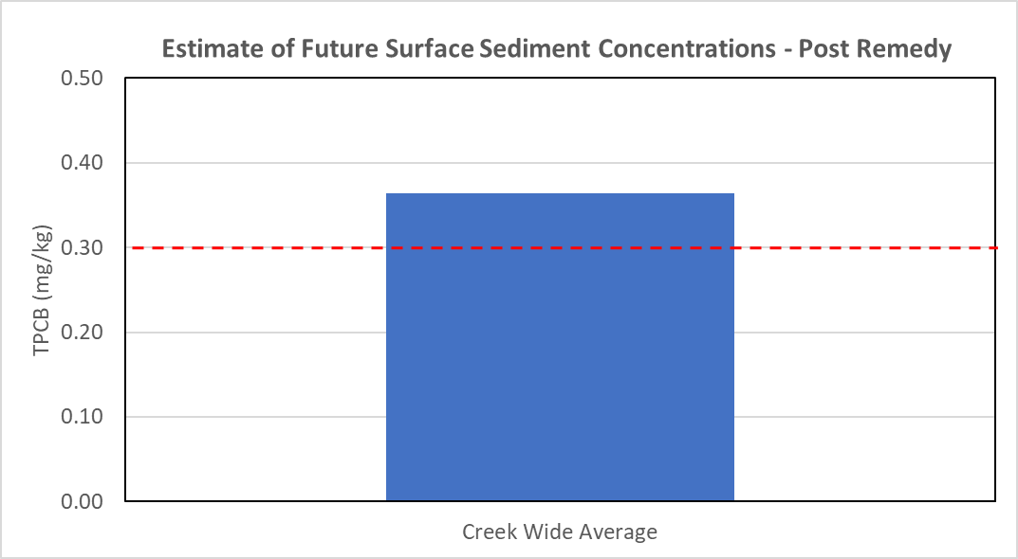
Comparison of Background with Risk-Based PRGs
Background is an estimate of the steady-state concentrations in the Creek after the entire Site has been remediated.
  Assumes ongoing sources continue at current levels.
  Ongoing sources include; East River, point sources, groundwater, shoreline erosion & atmospheric deposition.
  NAPL seeping from upland properties is not included as an ongoing source.
Background estimates are at or less than the risk-based PRGs for all COPCs except dioxin/furans.
Risk-Based PRG
- Human Health
Notes:
Less than 0.1 ppm

Slide 18
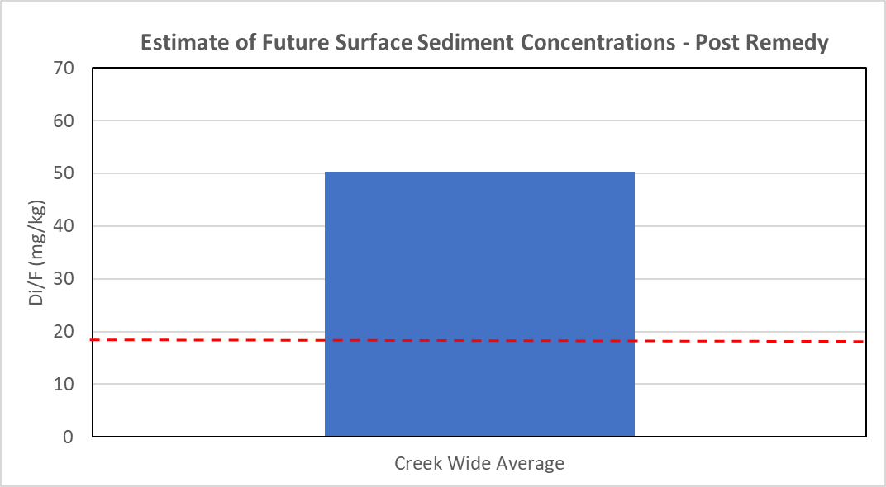
Comparison of Background with Risk-Based PRGs
Background is an estimate of the steady-state concentrations in the Creek after the entire Site has been remediated.
  Assumes ongoing sources continue at current levels.
  Ongoing sources include; East River, point sources, groundwater, shoreline erosion & atmospheric deposition.
  NAPL seeping from upland properties is not included as an ongoing source.
Background estimates are at or less than the risk-based PRGs for all COPCs except dioxin/furans.
Risk-Based PRG
- Human Health
IPM/IEM cannot be estimated accurately for C19-C36 due to data gaps associated with most sources used to develop this analysis

Slide 19
Concern 3: Comprehensive Source Control RAOs

Slide 20
Source Control RAO for EA and OU1 is not Comprehensive
Proposed Source Control remedial action objective for the Site requires control of NAPL/Oil migration from the sediments of the Creek, but not of NAPL/Oil migration from Upland Sites
Superfund sites usually consider Oil seeps as principal threat waste and include a goal for control of ongoing sources of oil inputs.
  Ongoing oil seeps from uplands have been documented by NYCDEP, NYSDEC and the public since 2016.
  Oil seeps leave slicks of oil and sheen on the surface water and impact the ecological receptors ( fish, crabs, bivalves, shrimp) directly.
  Contaminant concentrations in oil seeping from upland properties are well above risk levels
  Oils contaminate newly settling solids and subsequently the sediment
CSTAG has recommended the Region 2 to work with NYSDEC to control Oil seeps under Superfund and clarify the Source control RAO.
Notes:
Other stakeholders have stated
Don’t drop it all on the state

Slide 21
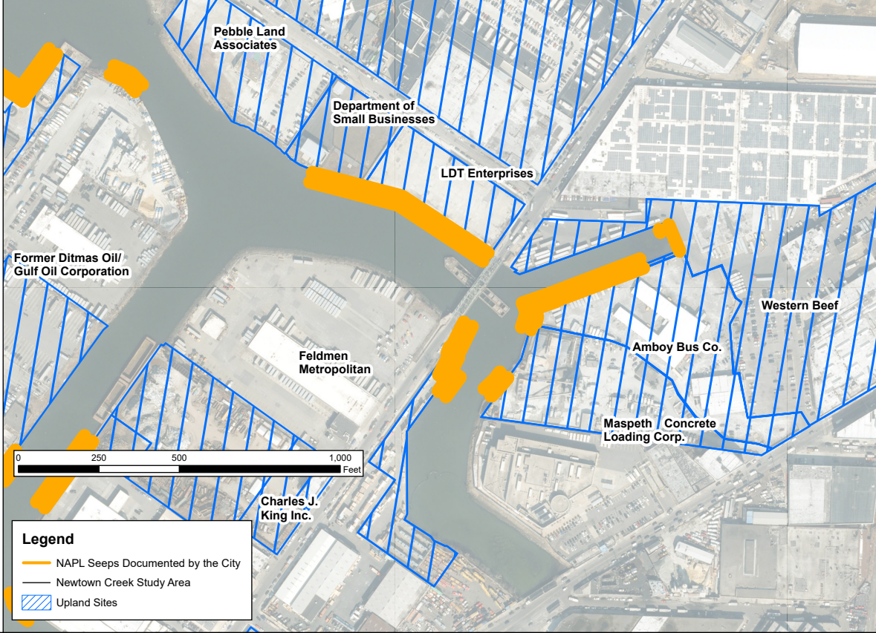
Source Control RAO for EA and OU1 is not Comprehensive
Proposed Source Control RAO for EA and OU1 states: “Reduce migration of site-related Non-aqueous Phase Liquid (NAPL) and other sources within the Study Area to sediment and surface water above levels that are protective for human health and ecological exposure.”
Terminology “within the study area” means that the source control RAO will not control/reduce ongoing migration of NAPL from Upland Sites.
Superfund sites include a goal for control and reduction from offsite impacts for NAPL inputs.
NAPL seeps from uplands have been documented by NYCDEP, NYSDEC and the public since 2016.
Characterization samples have been collected showing high COPC concentrations in NAPL seeping from upland properties.
Notes:
Lobe with NAPL, ebullition higher concentrations
2017 observations and sampling from boats
DEC has these sites but also western beef.

Slide 22
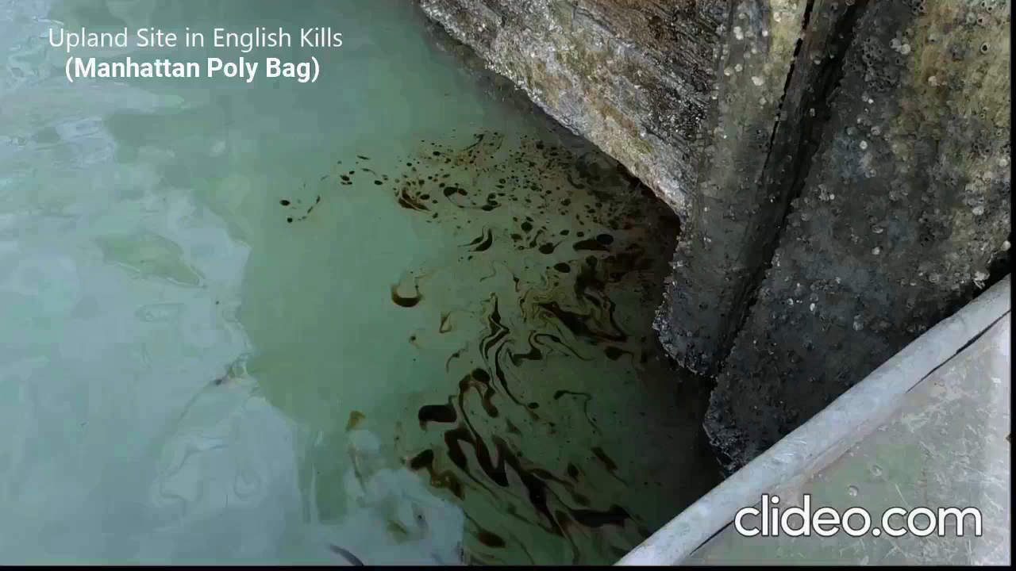
Videos Documenting NAPL seeps in EA and OU1
Notes:
Legacy and ongoing impact from industrial activities coming from or through multiple upland properties.
Sheens are a common occurrence on the creek
City has documented NAPL/Oil seeps from various Sites along the Creek including East branch. These have been validated by DEC.
Product seeping from various Sites with heavy historical industrial activity
Impacts of the historical activities are ongoing
NAPLs interact with suspended solids and settle as OPAs, NAPL also settle directly due to density differences on surface sediments and on exposed banks.
Fritro new bulkhead

Slide 23
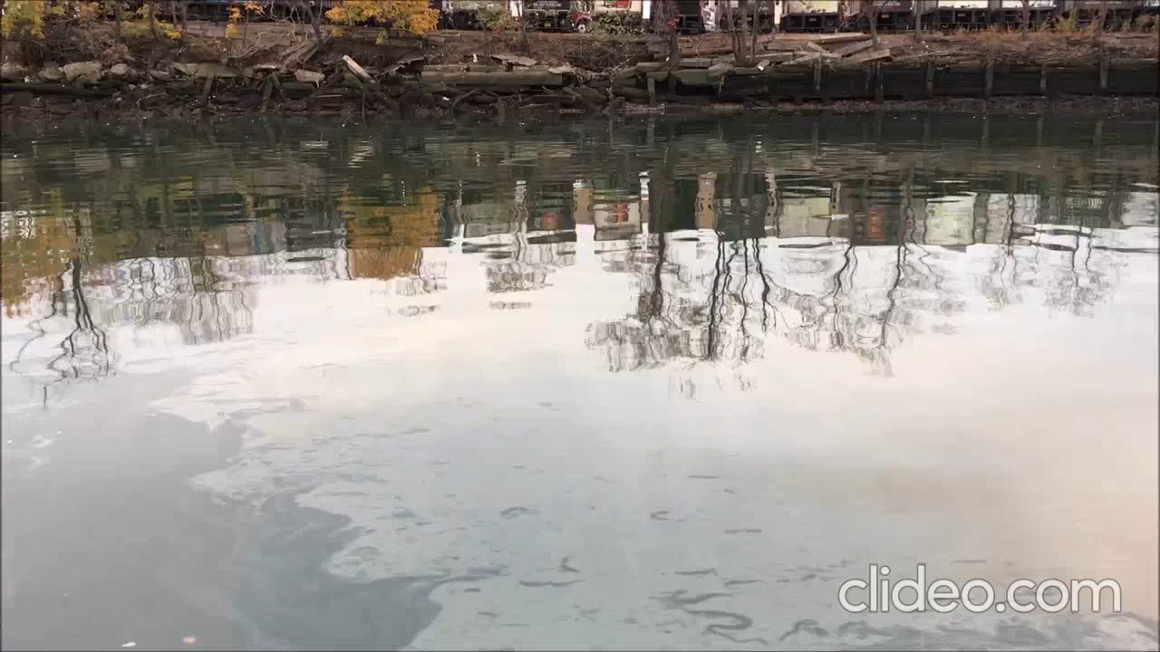
NAPLs Migrate Across the Creek from the Point of Entry
Notes:
Video shows bank to bank sheen for most of the Creek from a NAPL seep from a former refinery.
Ecological receptors such as Crabs, fish, birds (bivalves) are directly exposed to NAPLs and associated COPCs.

Slide 24
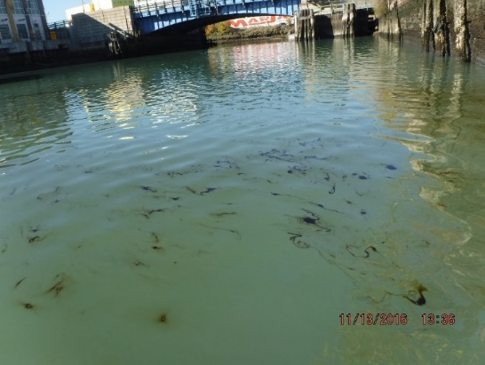
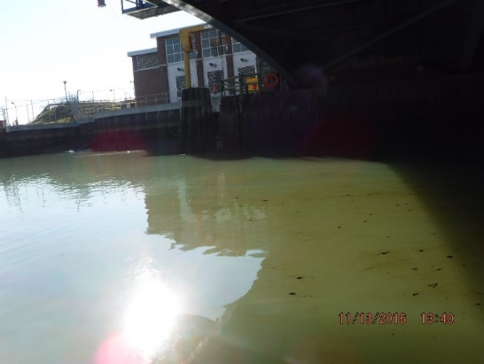
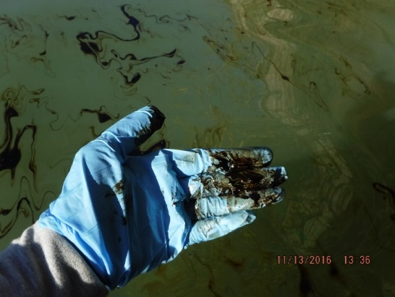
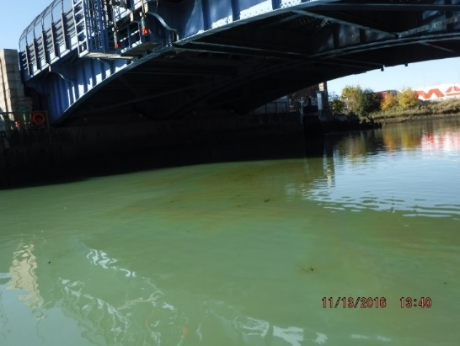
NAPLs Migrate Across the Creek from the Point of Entry
Notes:
Oil is seeping from Manhattan Polybag upstream of the bridge, but with low tide it is migrating from the point of origin to other parts of the Creek.

Slide 25
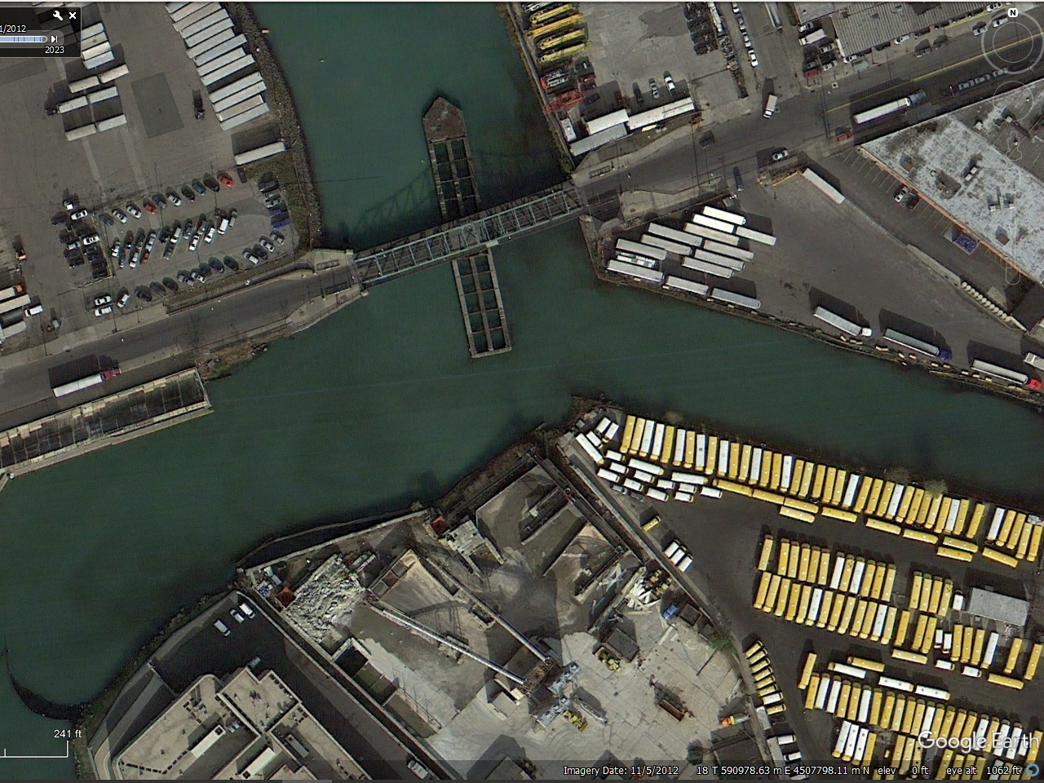
NAPL Slicks (severe than sheen) are seen in East Branch
East Branch with evidence of NAPL seeps from November 2012

Slide 26
High Contaminant Concentrations in NAPLs
Concentrations are expressed as mass of contaminant to mass of NAPL
Notes:
Concentrations are shown on log scale.
Very high concentrations of TPAH 34 – on average > 50,000 ppm
Comparable to NAPLs migrating due to ebullition

Slide 27
High Contaminant Concentrations in NAPLs
Concentrations are expressed as mass of contaminant to mass of NAPL
Notes:
Not PCB NAPLs, but do have PCB contamination
Very high concentrations of TPCB– More than 50% > than 10 ppm
Comparable to NAPLs migrating due to ebullition

Slide 28
High Contaminant Concentrations in NAPLs
Concentrations are expressed as mass of contaminant to mass of NAPL
Notes:
Log Scale
Very high concentrations of Petroleum Hydrocarbons – On average 400,000 pp,
Comparable to NAPLs migrating due to ebullition
High recontamination potential and direct exposure to eco receptors

Slide 29
Source Control RAO Must be Comprehensive
NYSDEC, the public and NYCDEP have collected samples which characterize COPC concentrations in Oil seeping from upland properties.
  Data has not been specifically collected for the RI/FS to characterize this source of COPCs.
  Although City and NYSDEC data is available to address this data gap for the RI/FS and EA FS, it has not been incorporated into RI/FS documents.
  USEPA lateral GW program has not collected any Oil Seep Samples as per their program - round1 has been completed, round 2 will start soon
COPC concentrations in NAPLs entering the Creek from the upland properties is high and comparable to NAPL migrating within the study area.
  CFT model developed for the OU-1 and EA sets the COPC loads from this source and lateral groundwater to zero.
  Oil Seeps and their Impact have been ignored or downplayed by not considering available data
Notes:
There’s a lot of NAPL, CFT does not include.
DEC is starting this saw from their presentations.
Not systematic NAPL seeps can fall through the cracks.

Slide 30
Source Control RAO Must be Comprehensive
The RAOs for the EA and the Site must include control of NAPL/ Oil migrating from upland properties.
  Many ecological receptors including bivalves, birds, fish etc. are exposed to NAPL and associated COPCs directly.
  Coordination of regulatory bodies will be important for controlling NAPL upland sources under USEPA CERCLA program.
Performance monitoring and PDI proposed for EA (and OU1) must include systematic NAPL seep surveys and consider ongoing impacts from other un-remediated parts of the Creek.
Either USEPA should collect data from NAPL seeps or data collected by NYSDEC or NYCDEP must be included in the RI/FS.
The risk to ecological receptors and human health will continue if the NAPL seeps from Upland Sites are not controlled.
Post-remedial recontamination due to NAPL seeps will occur.
Notes:
sequencing

Slide 31
Concern 4: Upland Control and Bulkhead Stability Must be Assessed During EA FFS

Slide 32
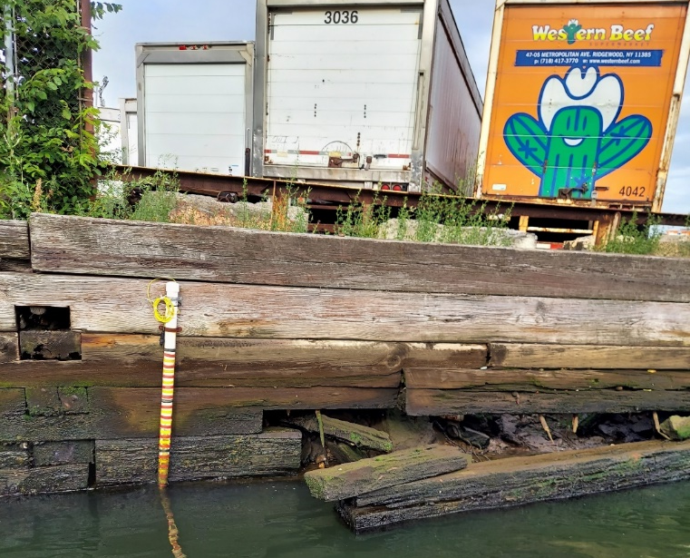
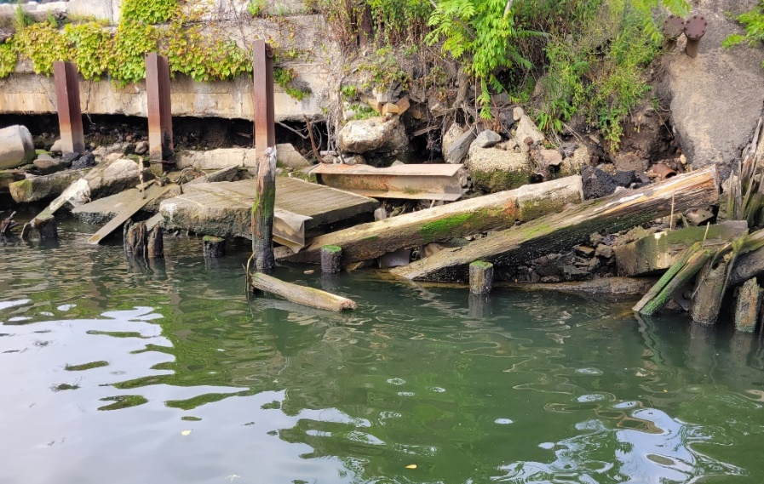
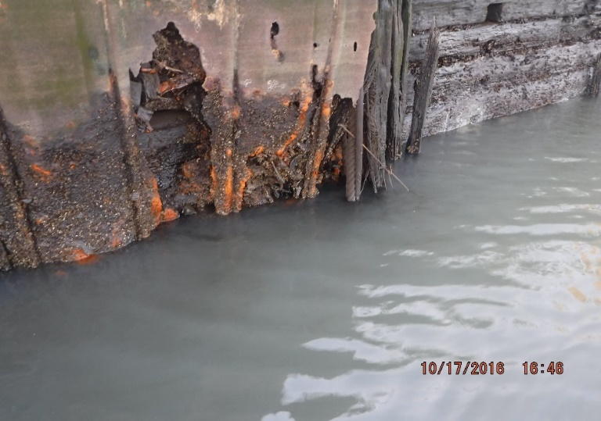
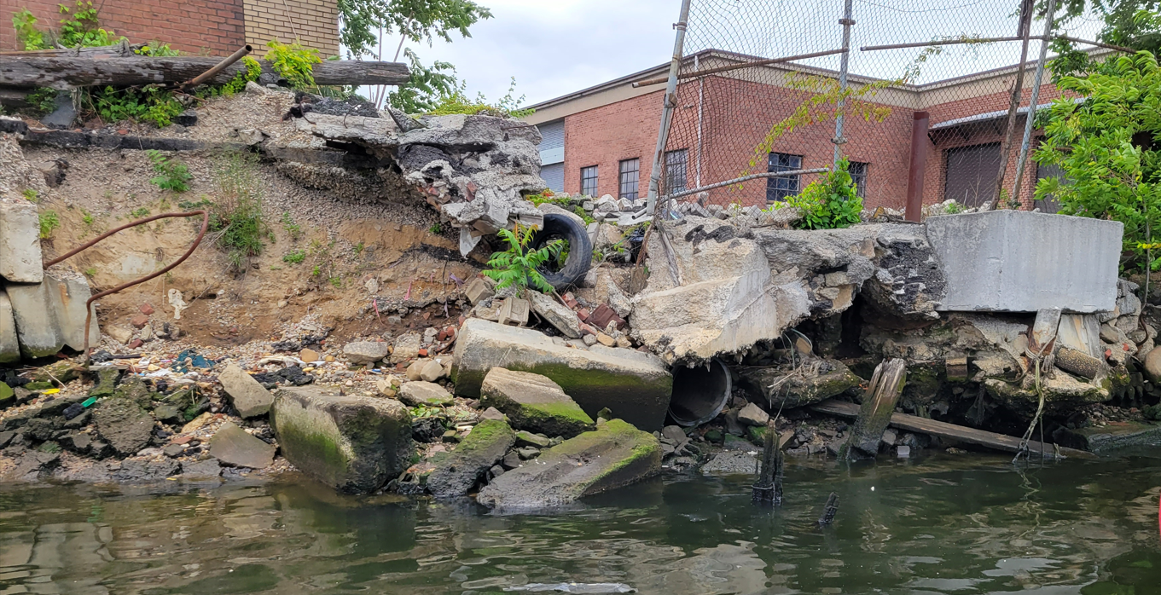
Upland Control and Bulkhead Stability
Most of the shoreline along the Study Area, including East Branch are in poor condition.
FFS must consider bulkheads and the potential need to repair or replace them during alternative development in the FFS
Notes:
1st one in east branch

Slide 33
Concern 5: Applicability of EA to OU1

Slide 34
Applicability of EA to OU1
East Branch CSM may not be representative of other parts of the Site.
  Impacts of NAPL in other areas of the Creek on the surface sediments are even more significant than those in East Branch.
  GW impacts vary across the Site.
  Validation of CSM in the East Branch may not be indicative of validation of CSM in other parts of the Creek.
As per the approved schedule in Spring of 2023:
  EA FFS will be finalized in February 2024.
  The FS report for the OU1 is expected to be approved by Dec 2027.
  It is unlikely that the EA PDI will be completed in the time OU1 FS.
  Any lessons learned from the EA will not be available to help in determining the remedy selection for OU1.
  EA cannot be used as a blueprint for cleanup at other parts of the Creek

Slide 35
Next Steps

Slide 36
Summary of Primary Concerns
Anthropogenic Background must be used to develop PRGs for the Site.
Investment of $100M+ for EA, ~$1B for OU1, $1B for OU2 (NYC) – the EA remedy must be robust (CERCLA Evaluation Criteria for Cost Effectiveness):
  Source control RAO must include control of oil seeps from Upland Sites to be protective of ecological and human health. Sequencing needs to be considered along with RA - before recontamination!
  Data gaps associated with upland NAPL seeps must be addressed during pre-design investigation for the EA and during FS for OU1.
CSM for the Site is uncertain and needs to be updated after data gaps have been addressed to ensure remedy success.
  High uncertainty in sediment transport model.
  Data gaps in significant sources for complex CFT model make it unreliable.
The FFS must address these concerns for a successful EA

Slide 37
Recommendations from CSTAG 2023
Remedial Action Objectives
  Replacing the phrase “the concentrations of COCs in contaminated sediment” with “the exposure of biota to sediment COCs” in the first exposure-based proposed RAO, and
  rewording the proposed source control RAO to make clearer the definition of “site-related” (in reference to “site- related NAPL”) and the intent of the remedial action.
Upland NAPL Seeps
  the Region work with the NYSDEC to clarify how they intend to share responsibility for evaluating and remediating these potential sources of COCs.
    The Region clarify the remedial design decision process for assessing whether additional source control or protections, such as sealed bulkheads, will be needed for in-water work. This collaborative process for identifying and evaluating shoreline seeps may not be as critical in the EB, but it will likely become more important elsewhere in Newtown Creek.

Slide 38
Recommendations from CSTAG 2015 are Still Applicable
Principle 1 - Control Sources Early, Recommendation 1: “… address groundwater discharges that may re­contaminate the Creek.”
Principle 4 - Develop and Refine a Conceptual Site Model that Considers Sediment Stability, Recommendation 4: “…include a description of how any models used in remedy selection were reviewed, calibrated, validated, and how the uncertainties in model predictions were considered.”
Principle 5 - Use an Iterative Approach in a Risk-Based Framework, Recommendation 6: “…more quickly remediate the nonaqueous phase liquid (NAPL) sources near the manufactured gas plants, upland source areas not addressed by the State, and discrete hot spots…”
Recommendation 9: “…the CSTAG recommends that Region 2 develop a plan for evaluating information that was not generated under an EPA approved work plan...”
Principle 6 - Carefully Evaluate the Assumptions and Uncertainties Associated with Site Characterization Data and Site Models, Recommendation 10: “The determination of background concentrations for primary contaminants of concern is an important consideration...”
Principle 7 - Select Site-specific, Project-specific, and Sediment-specific Risk Management Approaches that will Achieve Risk-based Goals, Recommendation 13: “…consider whether bulkhead upgrades are necessary as part of any remedy…”
Recommendation 14, “…determine where the coal tar/NAPL is located within the Study Area… how the coal tar is entering the Creek will be critically important for evaluating effective remedies in the FS to contain, treat, or remove it.”

Slide 39
Q&A

